Slide 1

Department of Biosciences and Chemistry
College of Health, Wellbeing and Lifesciences
Diagnostic Workforce
Graduate Diploma in Respiratory Science
Webinar – Wednesday 15th March 2023
Dr Anne-Marie Harrison – Course Leader for BSc Healthcare Science Degree Apprenticeship
Notes:
1

Slide 2
Presentation Overview
Introduction to Sheffield Hallam University, Department of Biosciences and Chemistry
Planned Course Structure and Delivery
Notes:
2

Slide 3
College of Health, Wellbeing and Life Sciences
A strong track record of practice-focused, work-based and technology enhanced learning,
Partnership working with NHS, especially in Nursing and Midwifery and Allied Health Professions
BSc (Hons) Biomedical Science is our largest course. Accredited by IBMS since the 1970s. Sandwich placements in regional hospitals.
Active involvement in trailblazer groups
Our degree apprenticeship BSc (Hons) Healthcare Science: Cardiovascular, Respiratory and Sleep Sciences has been running since September 2017
Notes:
Sheffield Hallam An exceptional, multi award winning university and one of the largest in the UK, with around 32,000 students, 4,500 staff
Sheffield Hallam University Mission
transforming lives through excellent teaching, dynamic partnerships, civic engagement with our city and region and compelling research which makes a real difference.
3

Slide 4
Course Overview
Course structured to meet requirements of Graduate Diploma specification, using existing material and modules from BSc Healthcare Science: Cardiovascular, Respiratory and Sleep Sciences
Support and monitoring processes based on those used for Apprenticeship
Assessment tools based on Apprenticeship e.g. Pebblepad portfolio to evidence competencies and Professional Practice
Notes:
4

Slide 5
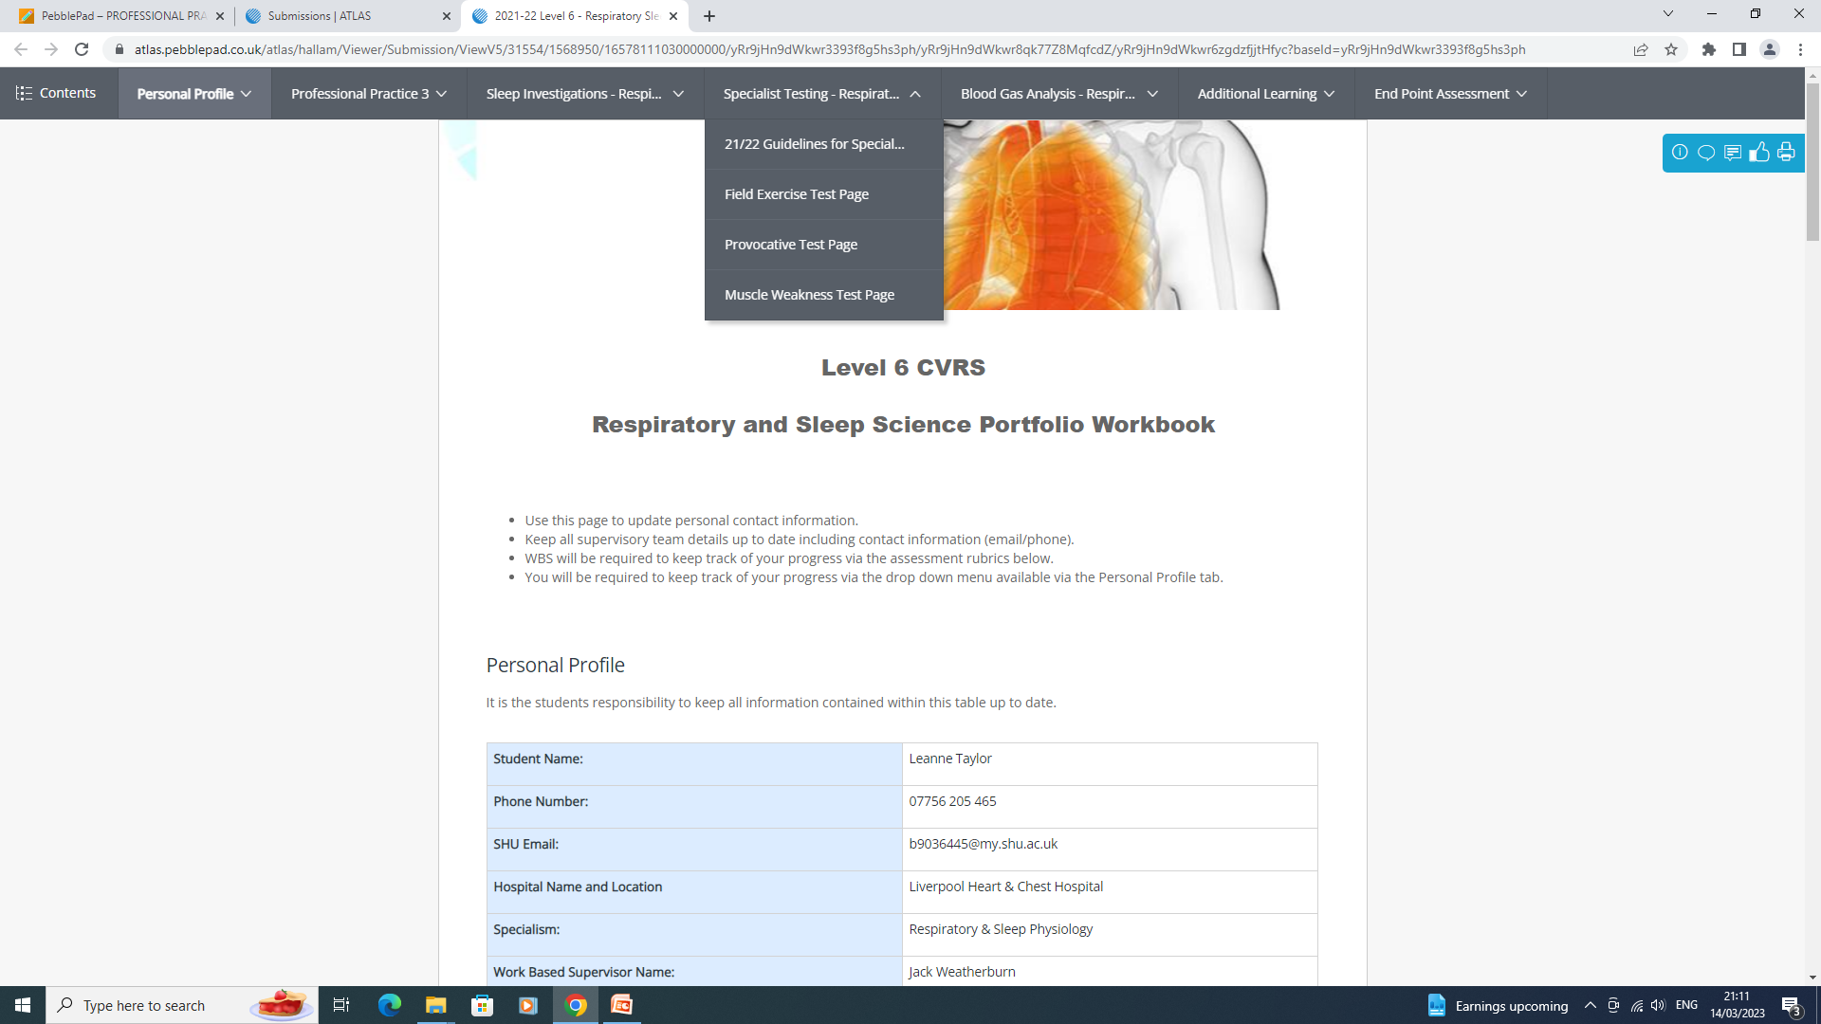
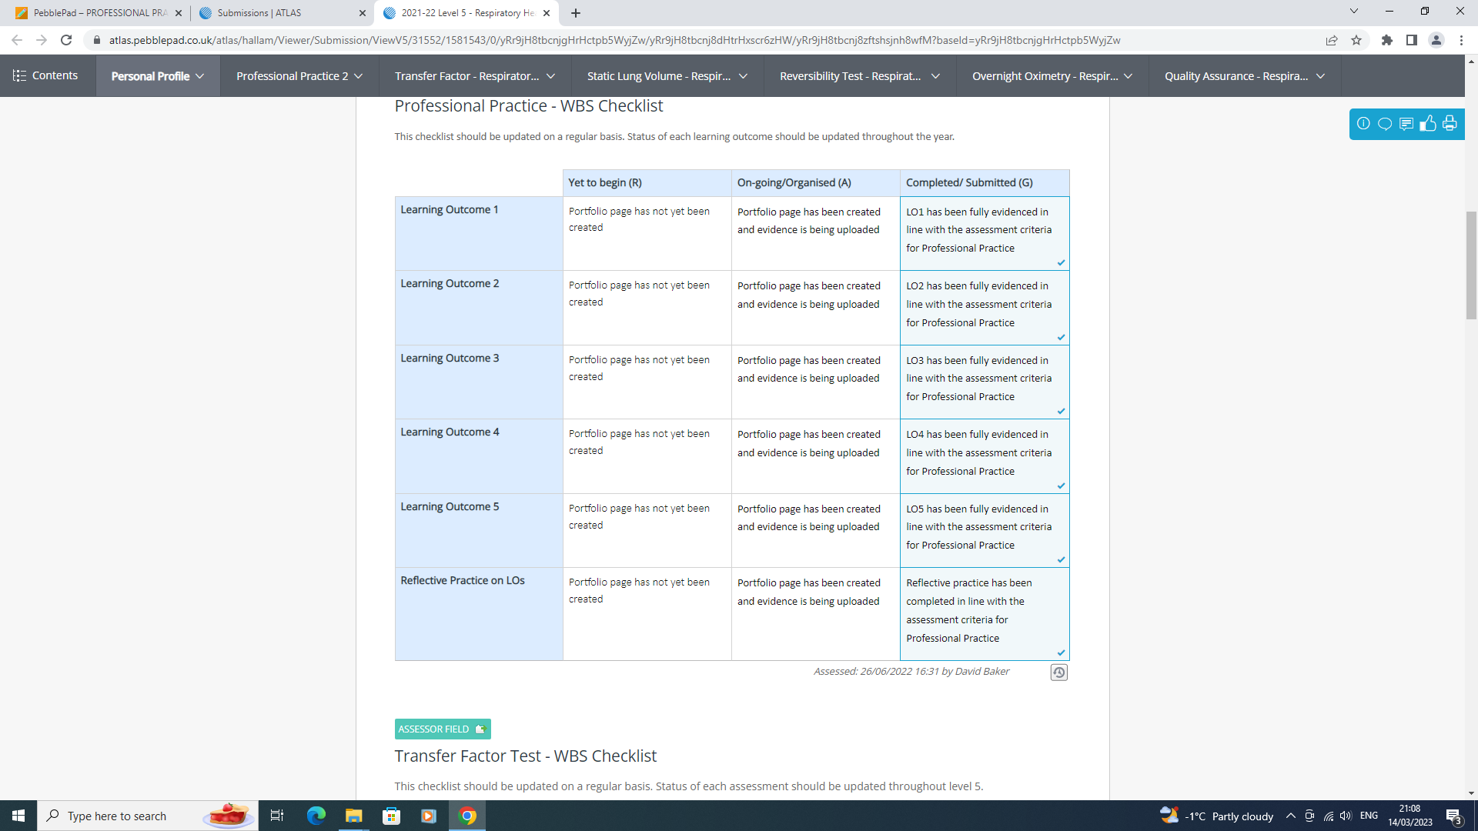
Notes:
5

Slide 6
Proposed Course Modules
Module | Credits | Notes
Instrumentation Signal Processing and Imaging | 20 | Will be the existing Level 5 Module from BSc Healthcare Science
Professional Practice for Respiratory and Sleep Physiologists | 40 | New module for this programme but based on the existing Professional Practice strand in the BSc Healthcare Science
Respiratory and Sleep Physiology | 40 | New module for this programme but based on scientific, professional, technical content of existing Respiratory and Sleep specialist modules at levels 5 and 6 on BSc Healthcare Science
Respiratory Work Based Training | 40 | New module for this programme but based on existing clinical competency specialist modules at levels 5 and 6 on BSc Healthcare Science
Notes:
6

Slide 7
Block Structure
Some common teaching with final year of BSc Healthcare Science: Cardiovascular, Respiratory and Sleep Sciences apprenticeship
  aspects of clinical work and professional practice
Some separate short blocks
  Induction block
  Final Block
Notes:
7

Slide 8
Module Delivery Pattern
Spring/Summer 2023
Application & Enrolment
Induction
Block 1 – October 2023
Instrumentation Signal Processing and Imaging
Professional Practice for Respiratory and Sleep Physiologists
Respiratory and Sleep Physiology
Respiratory Work Based Training
Block 2 – December 2023
Block 3 – March 2024
Block 4 – May 2024
Notes:
Module Delivery
Instrumentation, Signal Processing and Imaging - existing BSc Healthcare Science: Cardiovascular, Respiratory and Sleep Science apprenticeship module
SHU team
Professional Practice for Respiratory Physiologists – new module based on existing Professional Practice strand in apprenticeship
Work based learning, teaching and support from SHU clinical and academic teams
8

Slide 9
Proposed Delivery Team
Respiratory and Sleep Physiology based on existing clinical theory modules on apprenticeship
Team of associate lecturers who are clinical practitioners
Respiratory Work Based Training based on existing portfolio of clinical competence from apprenticeship
Work based supervisors/assessors, ‘SHU clinical team’
SHU apprenticeship delivery team
Notes:
9

Slide 10
Support and Monitoring: Student
Each learner allocated an academic advisor and clinical tutor – will monitor progress, liaise with workplace, provide pastoral support. Initial review of skills and knowledge
Monthly progress meetings with designated workplace supervisor to be reported back to course leader via e-portfolio
Monthly course team meetings to confirm progress of all learners, identify any concerns –
  escalation to department and College level if necessary via existing governance structures
Notes:
10

Slide 11
Support and Monitoring: Student
Full access to Hallam Help Student Support System
Learning Centre support – Online, and open 24/7
Employer support sessions twice per semester
Attendance Monitoring
Notes:
11

Slide 12
Support and Monitoring: Workplace
Pre-course Training the Trainers session
Twice semesterly ‘catch-up’ sessions to update, discuss general issues
Allocated clinical and academic tutor for each student
Regular contact with SHU
Notes:
12

Slide 13
Proposed Timeline – Cohort 1
April –
July 2023
August– September 2023
Trimester 1
October 2023 – January 2024
Trimester 2
January 2024 – June 2024
Trimester 3
July 2024 – September 2024
Hallam Course Approval
Liaise with NSHCS re admissions
Set-up Blackboard Sites
learners enrolled, engage with pre-course activities
Training the Trainers for work based supervisors
Course Begins
October First On-campus block teaching week
Second block week December 2023
Workplace visit # 1
Teaching continues
Block delivery weeks:
  March 2024
  May 2024
Workplace visit # 2
Workplace Training continues
September 2024
Final Exam Board
First Graduates enter workforce
Grad Diploma approved
Learners enrolled
Blackboard Sites Ready
Course Begins
First block weeks completed
Modules completed:
Instrumentation, Signal Processing and Imaging
Respiratory and Sleep Physiology
Modules completed:
Professional Practice for Respiratory Physiologists
Respiratory Work Based Training
Repeated in 24/25 for Cohort 2 & 25/26 for cohort 3
Notes:
Proposed Timeline
Summer 2023: Liaise with the National School of Healthcare Science re. admissions
August/September: learners enrolled, engage with pre-course activities, Training the Trainers for work based supervisors
October: first on campus sessions
Further on campus attendance December 2023, March 2024, May 2024
Workplace visits each semester
April/May 2024 Instrumentation, Signal Processing and Imaging and Respiratory and Sleep Physiology modules completed
June: modules ratified at exam board
June/July/August Professional Practice for Respiratory Physiologists and Respiratory Work Based Training modules completed
September: modules ratified at exam board
Completion of Graduate Diploma
13

Slide 14
Getting Feedback
Student feedback – via Student Voice and module evaluation
Employer feedback via Training the Trainers, Semesterly meetings and regular reviews
identify any issues arising and take appropriate action
external examiner / internal moderator comment
Feedback to students and/or employers
Notes:
14

Slide 15
Summary
Block attendance spread over 4 occasions
Experienced clinical tutor support for student and workplace
Experienced student support and monitoring
Questions?
Notes:
15

