Slide 1
What are we expecting from you in the next two months?
Presented by:
Dr EMma Bowers
Notes:
Standard title slide

Slide 2
Your planning…
SEPTEMBER 2023
OCTOBER 2023
M | T | W | T | F | S | S
 |  |  |  | 1 | 2 | 3
4 | 5 | 6 | 7 | 8 | 9 | 10
11 | 12 | 13 | 14 | 15 | 16 | 17
18 | 19 | 20 | 21 | 22 | 23 | 24
25 | 26 | 27 | 28 | 29 | 30
M | T | W | T | F | S | S
30 | 31 |  |  |  |  | 1
2 | 3 | 4 | 5 | 6 | 7 | 8
9 | 10 | 11 | 12 | 13 | 14 | 15
16 | 17 | 18 | 19 | 20 | 21 | 22
23 | 24 | 25 | 26 | 27 | 28 | 29
~5% of your training period
Notes:
Say what I am going to say
Make the most of today – particularly networking, I was in your position 25 years, still very much in touch with individuals I trained with both professionally and as friends
Quick get out clause – appreciate a number of you aren’t employed yet so the time scales will be slightly skewed, when I talk about tomorrow, next week or next month – I mean relative to your start date.
What we expect you to do, as I am sure you are beginning to realise your training should be driven by you.
I’m going to give you are whistle stop tour of what you should be doing tomorrow, in the next week, fortnight, three weeks, a month and in the following couple of months
Time passes by very quickly on STP – before you know it you will have completed a 5% of your training. Certainly wouldn’t expect you to complete a 5% of your competences – but certainly expect you to have the foundations in place so that you can be well on your way.

Slide 3
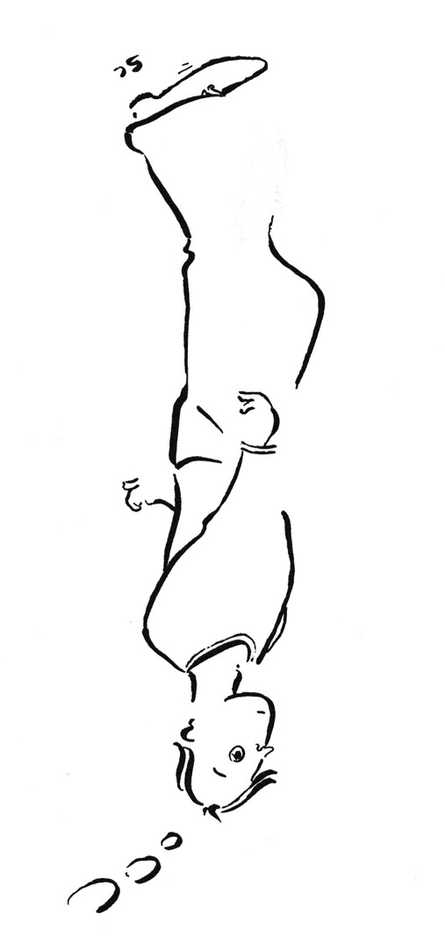

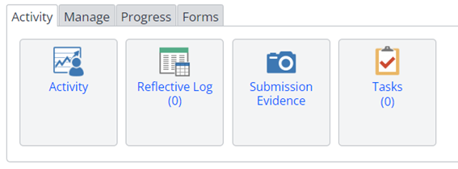
By tomorrow…
Reflect on today
Increase this by one
Notes:
Say it – By tomorrow
Reflect about today.
This isn’t something to put off, it is best done whilst it is fresh in your mind, so even if your aren’t employed, scribble some notes down on your train journey home so you can write it up when you start
Maintaining a reflective log throughout your training is important – there is a facility on OneFile to store your reflections.
Reflection is personal – I’m not going to say how regularly you should do it, some people write a little and often others less often but write more, others reflect more adhoc eg after ‘events’.
Start experimenting what is the best way for you
What is also useful for you – is to see your own development, referring back to your early reflections can be eye opening – particularly if you are having a bad day later on in your training, when you think you don’t know anything, looking back at the your own reflections is a way to reassure yourself that you are moving forward with your understanding.

Slide 4
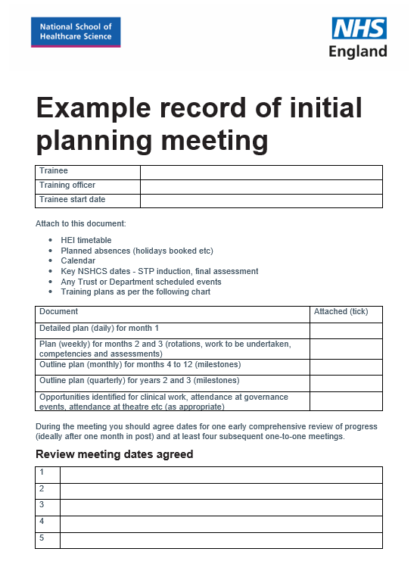

By next week…
Meet with your Training Officer
https://nshcs.hee.nhs.uk/publications/example-record-of-initial-planning-meeting-with-trainee/
Notes:
Say it – By next week
All your training officers have attended “Train the Trainer” and all your training centres are accredited
This means that Training Officers understand what STP is about and what expectations we have, it also means that we are reassured there are processes in place to meet our expectations.
Your first meeting with your Training Officer is likely to be long as there is loads of information you need to cover:
HEI timetable – possibly explain how to record it as study leave, explain that attending university is part of your employment contract, therefore no longer are lectures optional – expenses system, how it works within your trust
Annual Leave – you may need to compromise on when to take A/L as you can’t take it during university time, there may be QA tests that only happen once every three months so if you are away you might miss this training. Similarly important to know when your TO is away so you can tailor your plans accordingly.
Calendar/Timetable when you would be expected to do your rotations. When you are expected to be in different parts of your training department
Key dates – all on the website – but useful to cross reference with key departmental dates
Training plans – so you are aware of you should be doing
Your next month should be mapped out on a day by day level and will mainly contain local induction, meeting people and university attendance.
The following couple of months likely to be mapped out weekly
Then the milestones that you need to meet will be progressly further apart – but you will sort out the detail as they get closer.
You may well have information overload, so spend time after the meeting going through the documentation you have been given so that you understand what is expected of you, don’t hesitate to ask questions to clarify confusion

Slide 5
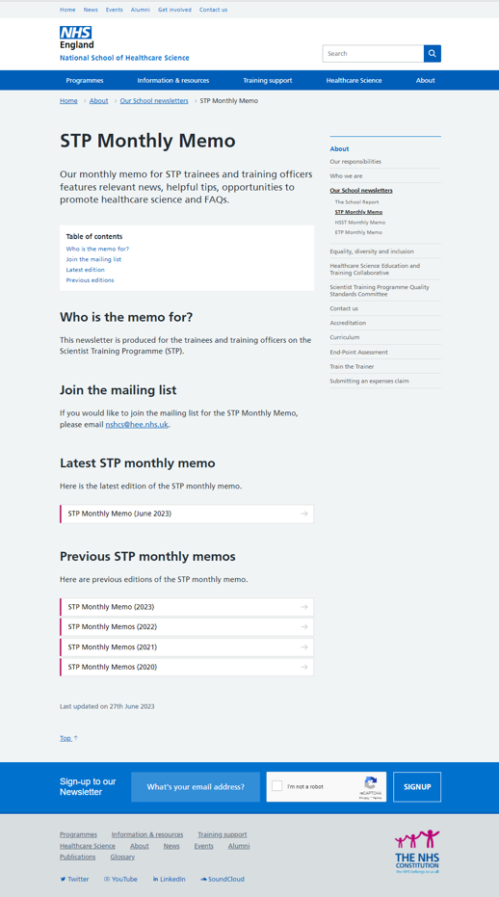
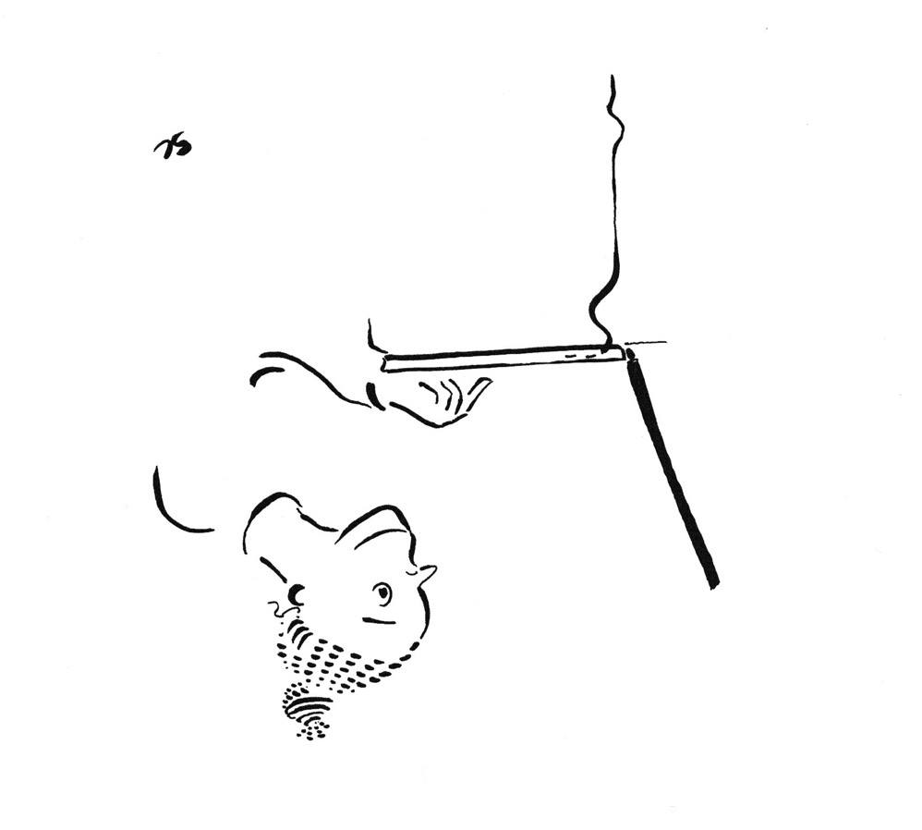
By next fortnight…
Read the Monthly Memo 18 September
https://nshcs.hee.nhs.uk/about/nshcs-newsletter/stp-monthly-memo/
Notes:
Say it – By next fortnight
You will have received your copy of the STP monthly memo on Monday 18 September
Professional email address
Monthly memo arrive on the third Monday of every month and are full of useful information for both you and your training officer
Make sure you and your training officer reads it
This is the main place where we update you of any changes, or advise you on what you should be thinking during that month.
Monthly memos are stored on the NSHCS website, but are best read as soon as they arrive by email as sometime there are some very time dependent task that need to be completed.
If the Monthly memo does not answer a question that you may have, then look on our website, which is the fount of all knowledge – the vast majority of questions directed at our school inbox are referred to the relevant section of the website

Slide 6
By three weeks…
Attend all the NSHCS Induction Webinars
Tuesday 12 September 16:00
Thursday 14 September 16:00
Tuesday 19 September 16:00
Thursday 21 September 16:00
Understanding work - based assessments
Getting to know the
OneFile e-portfolio service
Progression expectations and reviews
Question & answer session with panel of Training Programme Directors and Heads of Functions
Notes:
Say it – By three weeks
You will have completed all the induction webinars.
Deliberately kept to the end of the day to minimise clashing with academic lectures or Clinical Work, however if there is a clash the webinars will be recorded so you can watch them at an alternative time.
Prior to the first webinar:
You will be sent OneFile account details in the w/c 26 Sept.
After the first webinar “Getting to know the OneFIle e-portfolio service – you will be able to upload your reflection(s)
The other webinars you will be given pre-reading to complete.

Slide 7
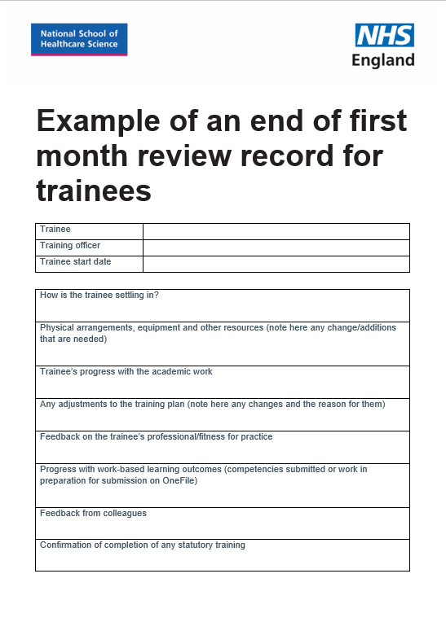

By next month…
Hold your first month training review
https://nshcs.hee.nhs.uk/publications/example-of-an-end-of-first-month-trainee-review-record/
Notes:
Say it – By next month
You should be reviewing what you have done and how you are getting on
Whilst at this stage I wouldn’t be expecting you to be working on competencies per se, you will be completing academic work which underpin the competences.
No longer can you complete an academic module and then forget what you have learnt – as you will be constantly applying what you learn in the workplace. To the point that when I was a Training Officer, I didn’t give trainees time off to revise as they should be constantly revising their work whilst in the work place (some TO are nicer than me!)
You should have completed your Trust’s mandatory training – same applies – don’t forget it, you need to be in a position to apply it at any time, whether it be recognising an information governance breach or identifying a safeguarding incident.

Slide 8
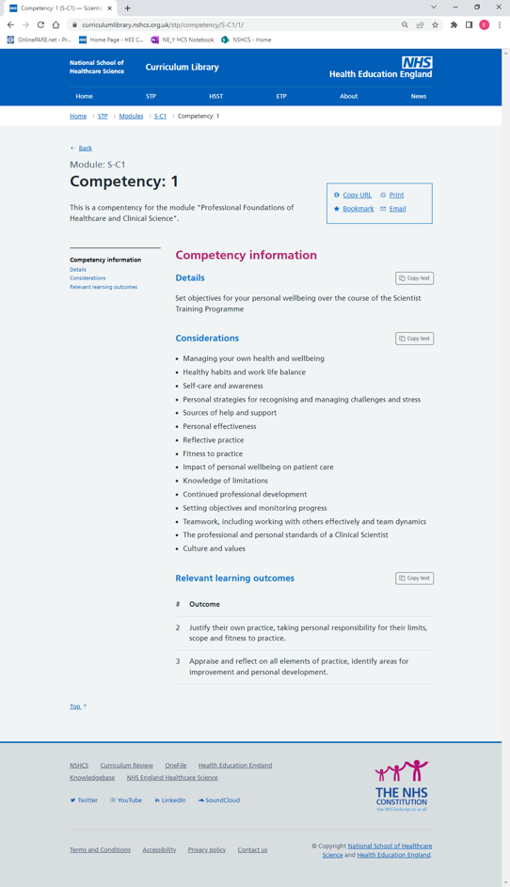
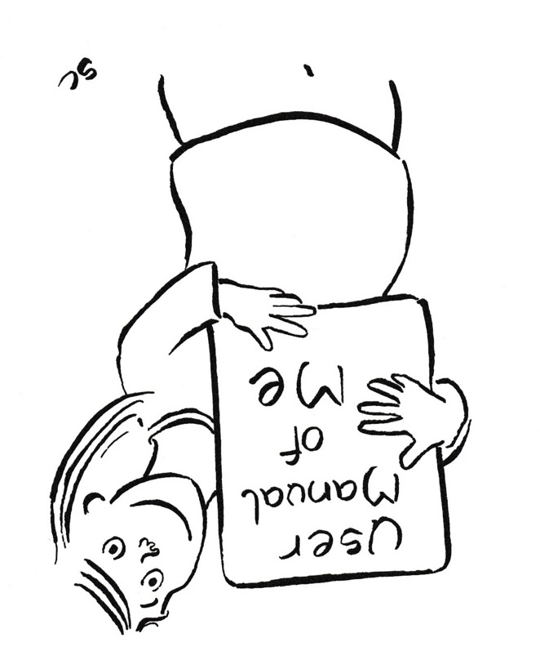
By two months…
Core Module –
Professional Foundations of Healthcare and Clinical Science
Competency 1 –
Set objectives for your personal
wellbeing over the course of the
Scientist Training Programme
The best ways to communicate with me
The ways I like to receive feedback
Conditions I like to work in
Things I struggle with
Things I need
Things I love
https://curriculumlibrary.nshcs.org.uk/stp/competency/S-C1/1/
Notes:
Say it – By two months
By 2 months – you should be now appreciate what is expected of you
You should have developed a professional relationship with your Training Officer
We really recommend that you complete competency 1 of the Professional Foundations of Healthcare And Clinical Science
Essentially the competency is asking you to write an “user manual of me”
This is the opportunity for you to discuss with your TO concerns you may have developed over these 2 months and strategies to alleviate them. It is also a useful document to share with Rotational Training Supervisors as you pass through your rotations as they won’t have the time by get to know you as your training officer has. You also might find it useful to share with your academic supervisor or other people involved in your training. It is your document so you can share it with who you like!

Slide 9

Your to do list…
To Do List
☑ Reflect on today
☑ Meet Training Officer
☑ Read Monthly Memo
☑ Attend Webinars
☑ Review Training
☑ Complete Competency 1
(Prof. Foundations of HC & CS)
Notes:
Say what I have said – Your to do list
So in summary
By tomorrow – I want you to reflect on today
By next week – I want you to have had a detailed meeting with your TO
When the Monthly Memo arrives on the 19 September – I want you to read it
By three weeks – you should have completed all the NSHCS induction webinars
By a month – I want you to have reviewed your training progression and how you are settling in with your TO
By two months – I want you to have got your first Professional Foundations of Healthcare and Clinical Science signed off

Slide 10
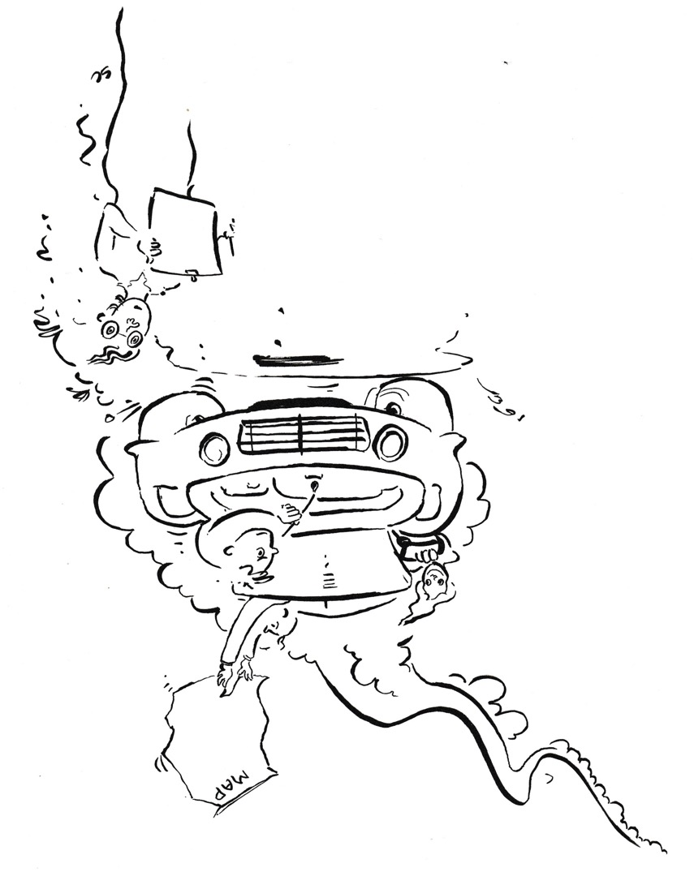
Some reminders…
Your
Training
Officer
You
ENJOY
NSHCS
Notes:
Say what I have said
Finish on a positive note
Whilst we are expecting you to drive your training you are not driving alone:
Your Training Officer is your navigator
The NSHCS tops up your oil (webinars)
The NSHCS completes your MOT (progress checks)
Others are on a similar journey – enjoy meeting them
Most importantly enjoy your adventure

Slide 11
End slide

