Slide 1
Creation of the Echocardiography Training Programme
Jane Lynch, Training Programme Director

Slide 2
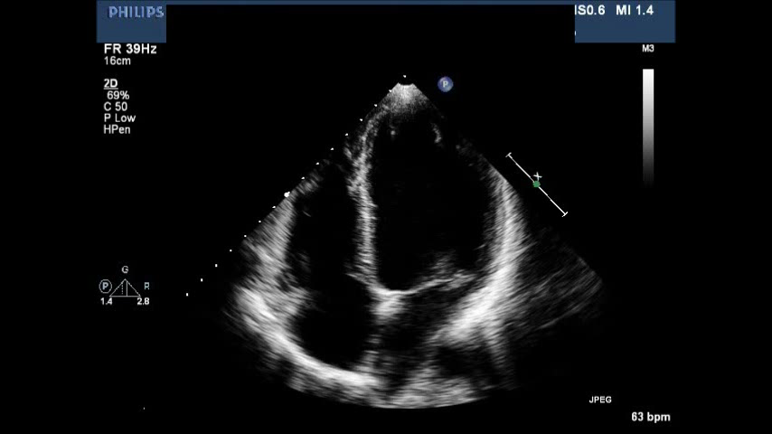
Echo is a vital diagnostic tool
Safe
Economical
Reliable
Structural and functional information
Plays a vital role in many healthcare pathways

Slide 3
Why was the ETP developed?
Insufficient trained echocardiographers to meet current and future demands.
Notes:
3

Slide 4
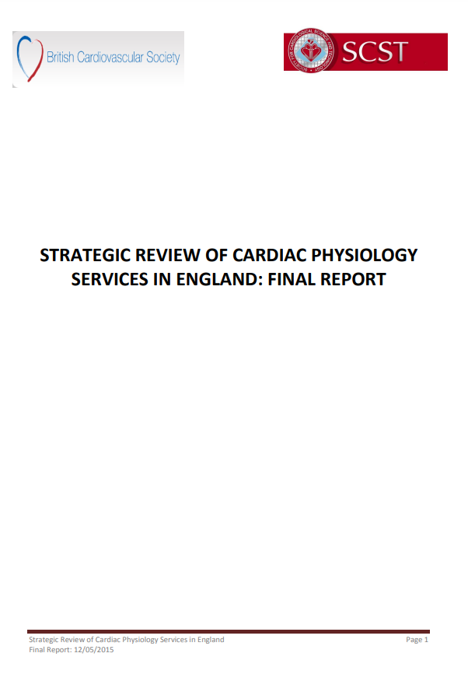
1. Existing shortfall in cardiac physiology workforce
UK - echo generally performed and reported by cardiac physiologists / clinical scientists
2019 – estimated shortfall of 363 WTE
Notes:
4

Slide 5
2. Decline in numbers entering the workforce
Practitioner Training Programme (PTP)
Visibility
Learning support fund
Introduction to Echocardiography
Training capacity
Scientist Training Programme (STP)
Broad curriculum
3-year programme
BSE usually gained after completion
Training capacity
Notes:
5

Slide 6
3. Increasing demand
Ageing population
increase in heart failure, valve disease, multimorbidity
New indications
oncology, screening, transcatheter valve interventions
Improved treatment and decreased mortality
heart failure, congenital heart disease
First line diagnostic test
breathlessness, pre-operative, chest pain
Estimated 6% increase per annum prior to Covid-19 – 43% 2009-2015
Notes:
6

Slide 7

4. Variation in supply
NHS Atlas of Variation 2015
39.5-fold variation in supply of Echo across the UK
better access = better survival rates
Notes:
7

Slide 8
5. Quality agenda
Long term plan
IQIPS
7-day services
Improving Quality in Physiological services
How to spread across more days safely?
Increased access to community clinics
Notes:
8

Slide 9
6. Dependency on locum, bank and agency staff
Flexibility
Pay
Reduces continuity
Reduces training capacity in the system
Notes:
9

Slide 10

Barriers to training in echo
BSE accreditation traditionally takes 3-4 years
Broad academic knowledge plus hands-on experience
Limited training capacity
Competing demands – cath lab, ETT, ECG clinics
Notes:
10

Slide 11
How can we tackle these?
Full time, supernumerary trainees – fast track programme
Integrated academic and work-based training
Funding support dedicated for 1 session Training Officer time
Regional Practice Education Facilitators/training co-ordinators
Funding for 24 Heartworks simulators nationally
Notes:
11

Slide 12
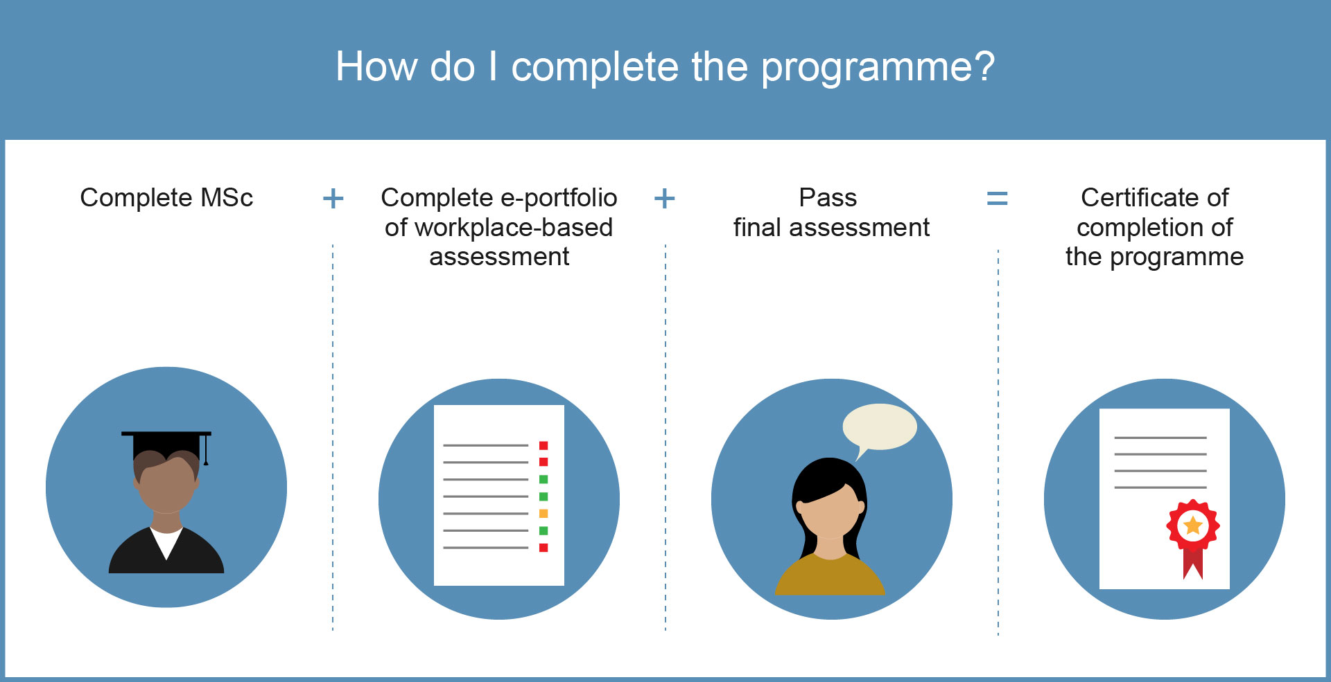
Complete Post-graduate Certificate in Clinical Echocardiography
Pass final assessment – BSE accreditation
Notes:
12

Slide 13
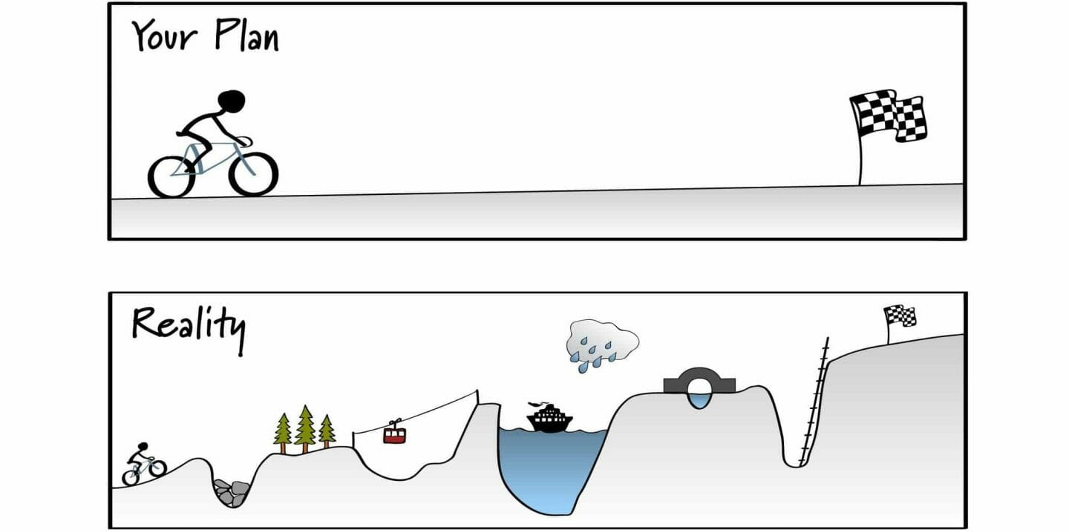
Becoming an echocardiographer: the journey
Notes:
13

Slide 14
What happens after the programme?

Slide 15

What happens after the programme?
STP equivalence – HCPC registration.
Notes:
15

Slide 16
Opportunities beyond qualification
STP
PTP
In house
International recruits
Training
Nurses
ETP
Anaesthetists
Cardiology registrars
Notes:
16

Slide 17
Other opportunities beyond qualification
Physiologist / scientist led services:
  Stress echo
  Transoesophageal echo
  Specialised clinics - RACPC, valve, Herceptin
Transaortic valve implantation (TAVI)
Research – supporting and leading:
  Clinical trials - drugs, equipment, valves
  Audit
  Service development
  Clinical academic careers
International volunteering and assessing
Assessing for the BSE, NSHCS, AHCS
Further training: e.g. HSST

Slide 18
My top tips for success on ETP
Be organised – know what you need to do and when
Get to know your Training Officer
Find a mentor
Network with other trainees and ETP alumni
Search out regional training support
Join BSE early and get to know the website
Contact University/NSHCS for help, support
Read the ETP memo and visit the website
Embrace the journey

Slide 19

Remember…

