Slide 1
Role of the National School of Healthcare Science
Sally Clee
Education Training Manager

Slide 2


Slide 3
Training standards
Plan, design and assess learning and training opportunities
01
Monitor your trainee’s progress and provide them with constructive feedback
02
Support your trainee in taking responsibility for their own learning
03
Embed Equality, Diversity and Inclusion into training
04
Know the limitations of your role and signpost to other sources of support, where appropriate
05

Slide 4


NSHCS Training Standards
NSHCS Training Standards | Trainee responsibilities
Familiarise yourself with the training standards and expectations

Slide 5

NHS Learning Hub
Quick guides to the training standards
Reflective practice in healthcare science

Slide 6
Training standard 5.
Know the limitations of your role and signpost to other sources of support, where appropriate

Slide 7

Training standard 5: Your responsibilities
Speak to your training officer
Keep lines of communication open
Be aware of the different training support options
Role of the National School of Healthcare Science
Maintain a positive, professional relationship with your training officer
Keep your training officer and the School informed
Look after your own mental health and wellbeing

Slide 8
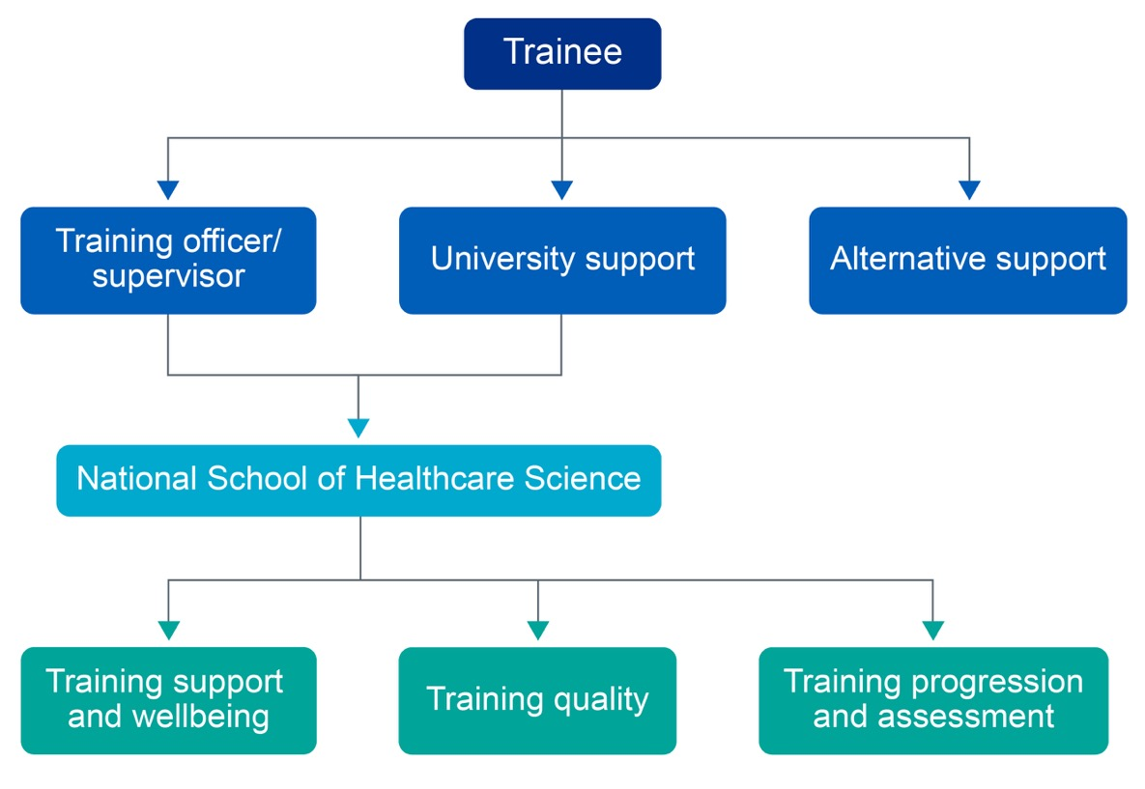

Accessing support or escalating concerns and issues

Slide 9


Training support and wellbeing
england.nshcs@nhs.net

Slide 10



Equality, Diversity and Inclusion
The School aims to enhance equality, diversity and inclusion throughout its work and all partnerships.
Chanelle Peters
Chair
Equality, Diversity and Inclusion Committee
Amrita Nanra
Deputy Chair
Equality, Diversity and Inclusion Committee
england.nshcs.edi@nhs.net​

Slide 11
Training standard 4.
Embed equality, diversity and inclusion into training

Slide 12

Training standard 4
Your responsibilities
Information from the School
External resources
NHS Learning Hub resources

Slide 13

Training standards and trainee responsibilities
Sign up to the NHS Learning Hub
Training Support and wellbeing
Equality, Diversity & Inclusion
Summary

